Slide 1

How Virtualization Enabled the Growth of Cloud Service Providers
Course Name:CSA1522-Cloud Computing and Big Data Analytics
CO1-AT2-Technical Presentation
Guided by:
Dr.P.Rajaram
Presented by:
Divyasree.M(192524098)

Slide 2
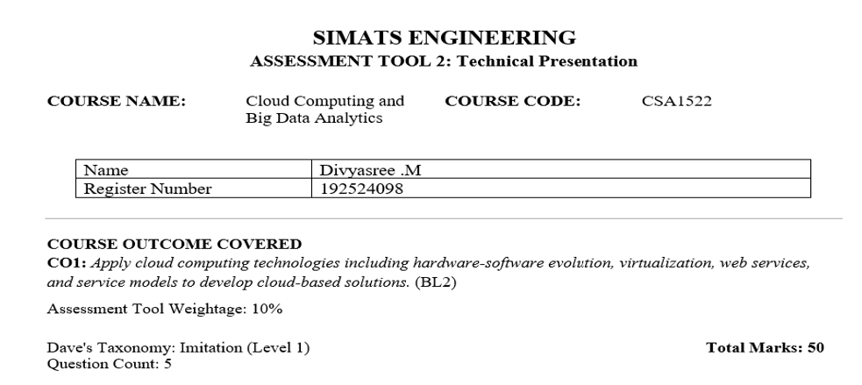

Slide 3
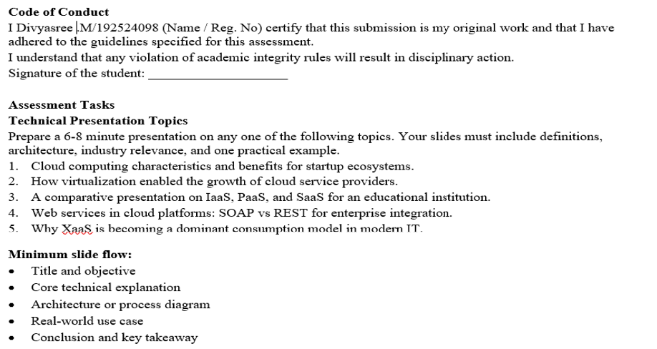

Slide 4
Introduction to Virtualization
Virtualization is the technology that allows multiple virtual machines (VMs) to run on a single physical computer.
Key Idea
One physical server can host many virtual servers.
Each VM has its own operating system and applications.
Resources such as CPU, memory, and storage are shared efficiently.
Benefits
Better resource utilization
Reduced hardware costs
Improved flexibility
Easier management

Slide 5
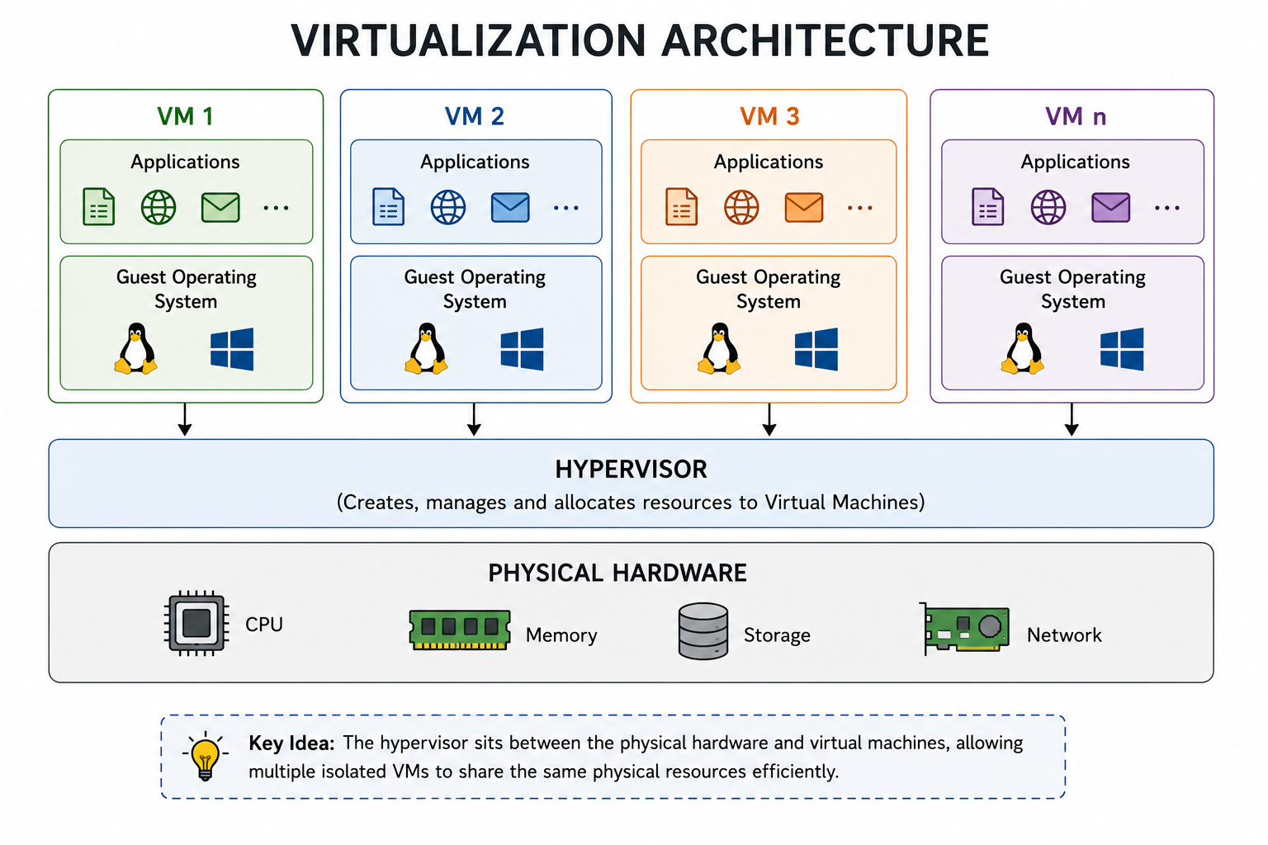
Architecture of Virtualization

Slide 6
Role of Virtualization in Cloud Computing
Virtualization became the backbone of cloud computing because it enables:
Resource Pooling-Multiple users share the same infrastructure.
Scalability-Resources can be increased or decreased on demand.
Isolation-Each virtual machine operates independently.
Rapid Provisioning-New servers can be created within minutes.
Cost Efficiency-Maximizes hardware utilization and reduces operational costs.

Slide 7
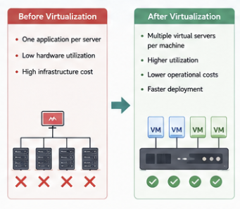
How Virtualization Enabled Cloud Service Providers
After Virtualization:
Multiple virtual servers per machine
Higher utilization
Lower operational costs
Faster deployment
Impact on Cloud Providers
Large-scale data centers became practical.
Customers could rent virtual resources instantly.
Pay-as-you-go model became possible.
Massive scalability was achieved.
Before Virtualization:
One application per server
Low hardware utilization
High infrastructure cost

Slide 8
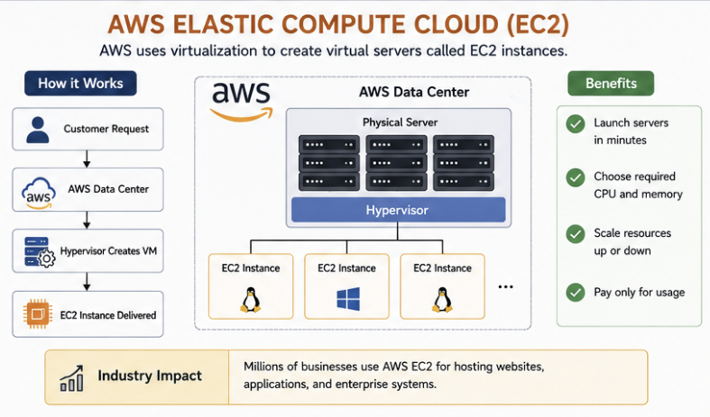
Real-World Example – Amazon Web Services (AWS)

Slide 9
Conclusion
Virtualization allows multiple virtual machines to run on a single physical server.
It improves resource utilization and reduces costs.Cloud providers use virtualization to deliver scalable and flexible services.
Technologies such as AWS EC2, Azure Virtual Machines, and Google Compute Engine rely heavily on virtualization.

